Slide 1
Our Cool App
A Group 5 Presentation

Slide 2
Team Members
Joel Gonzalez
Lauren Hastings
Vanessa Garcia De Quevedo
Zachary Shea
Brandyn Brinston
Brandon Haynes

Slide 3
Requirements
Create a personal contact manager with login
Each user should be able to add and delete their own contacts
The user interface should be clean and professional
The project should be professional

Slide 4
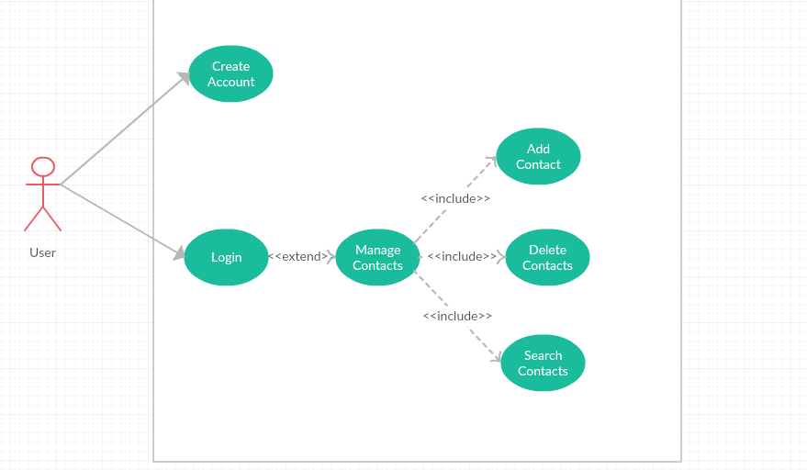
UML Diagram

Slide 5
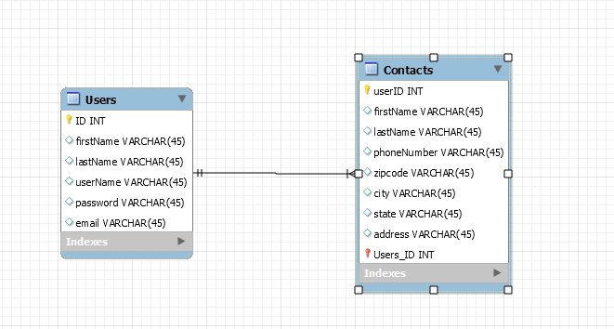
ERD

Slide 6

Questions?

